Slide 1

WEB TECHNOLOGIES
ABHIJIT SINGH

Slide 2
introduction
When you decide to develop an application using any programming language, one of the first problem you face is that programming languages do not include a library to create User Interfaces.
You need to use some framework to access the OS layer. Every programming language has at least one, but you need to choose it first.
One of the nice things about developing for the web is that the web provides a very rich and simple framework to create applications that include lots of features, not only interface but also access to peripherals (audio, input , gamepads, etc.),and this API is very easy to use.
Your Code
Framework
Operative System
Hardware

Slide 3
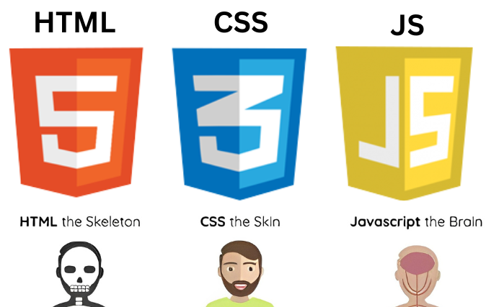
Roles in web development
Introduction to web technologies:
HTML to create the document structure and content.
CSS to control is visual aspect.
JavaScript for interactivity.

Slide 4

Markup Language
There are many markup languages that add special tags into the text that the renderer won’t show but use to know how to display the text.
In HTML this tags use the next notation:
My name is <b>Abhijit</b>

Slide 5
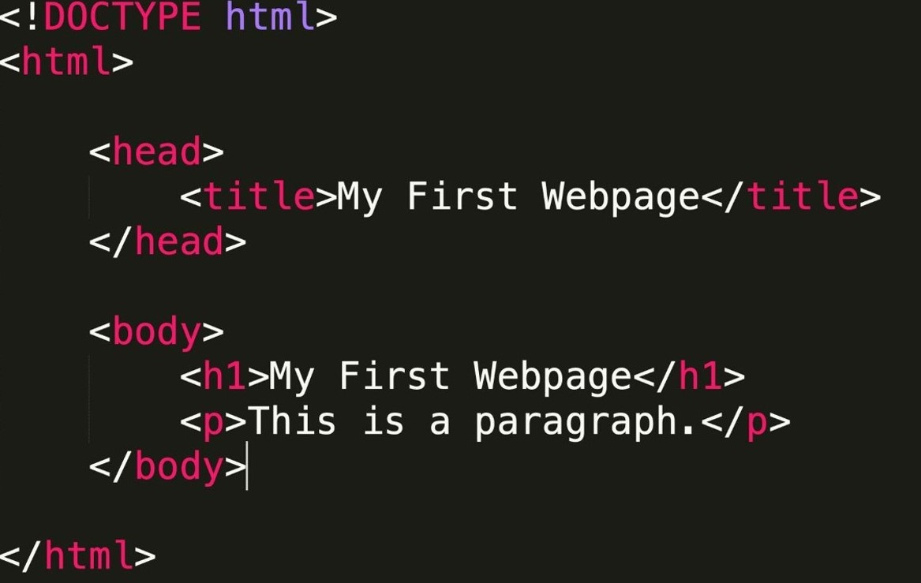
HTML
HTML means Hyper Text Markup Language.
The HTML allow us to define the structure of a document or a website.
HTML is NOT a programming language, it’s a markup language, which means its purpose is to give structure to the content of the website, not to define an algorithm.
It is a series of nested tags (it is a subset of XML) that contain all the website information (like texts, images and videos). Here is an example of tags:
<title>My First Webpage</title>
The HTML defines the page structure. A website can have several HTMLs to different pages.

Slide 6
Html: basic rules
Some rules about HTML :
It uses XML syntax (tags with attributes, can contain other tags).
<tag_name attribute=“value”> content </tag_name>
It stores all the information that must be shown to the user.
There are different HTML elements for different types of information and behaviour.
The information is stored in a tree-like structure (nodes that contain nodes inside) called DOM (Document Object Model).
It gives the document some semantic structure (like. This is a title, this is a section, this is a form) which is helpful for computers to understand websites content.
It must not contain information related to how it should be displayed (that information belongs to the CSS), so no colour information, font size, position, etc.

Slide 7
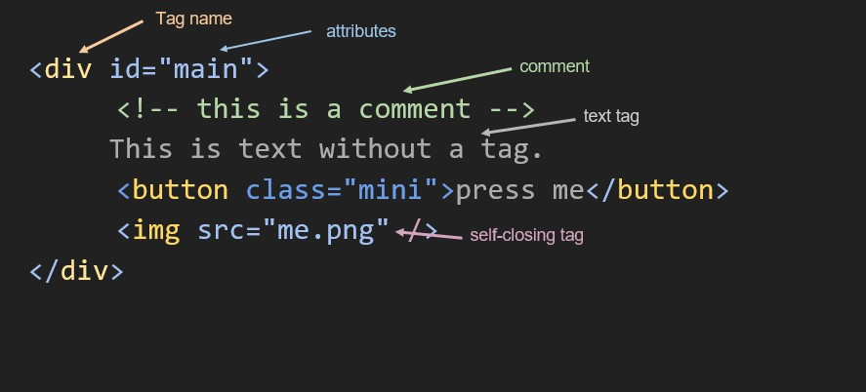
Html: syntax example

Slide 8
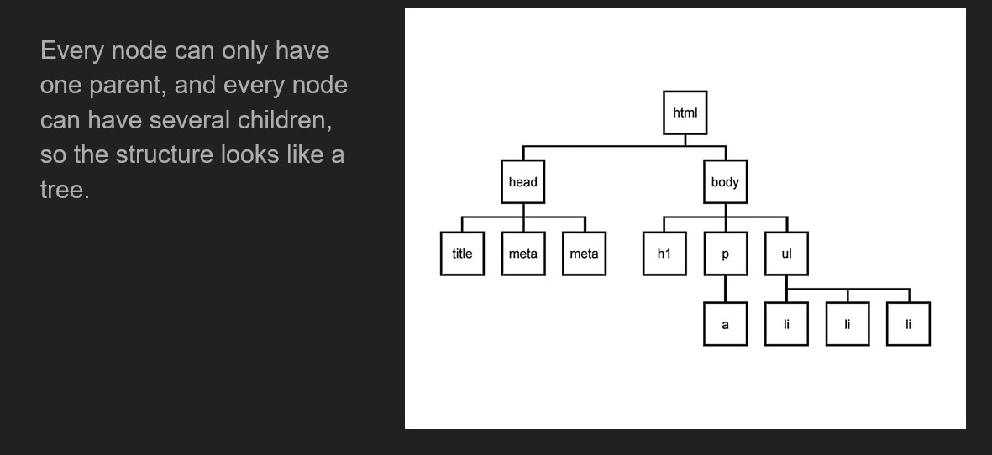
DOM is a tree

Slide 9
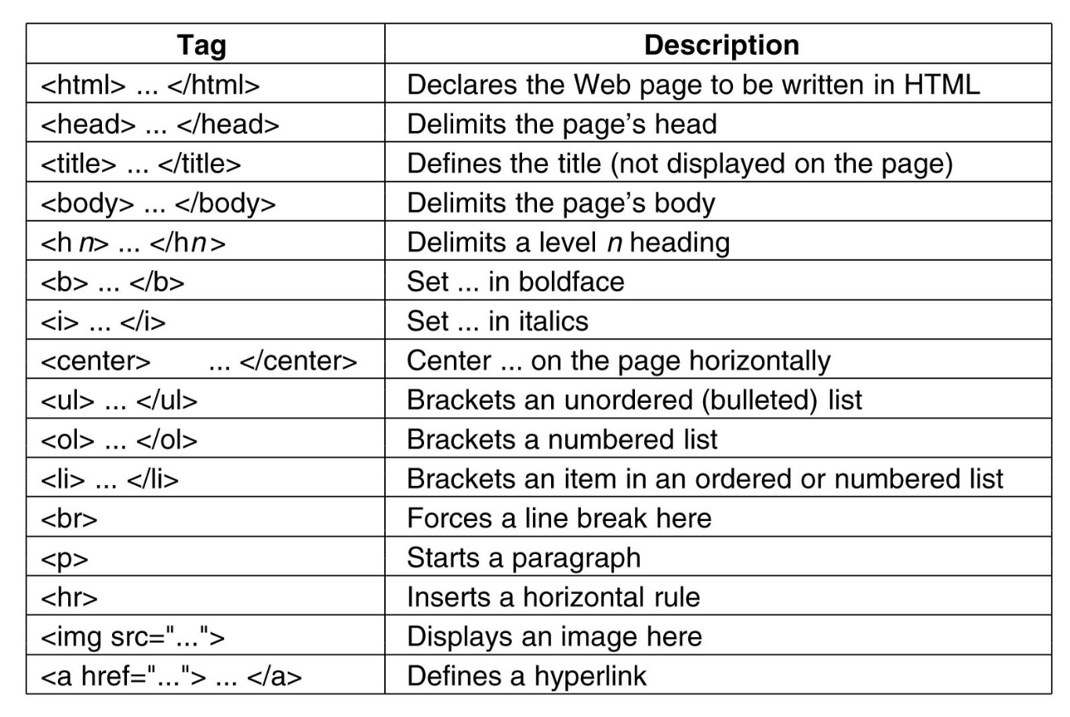
Html: main tags

Slide 10
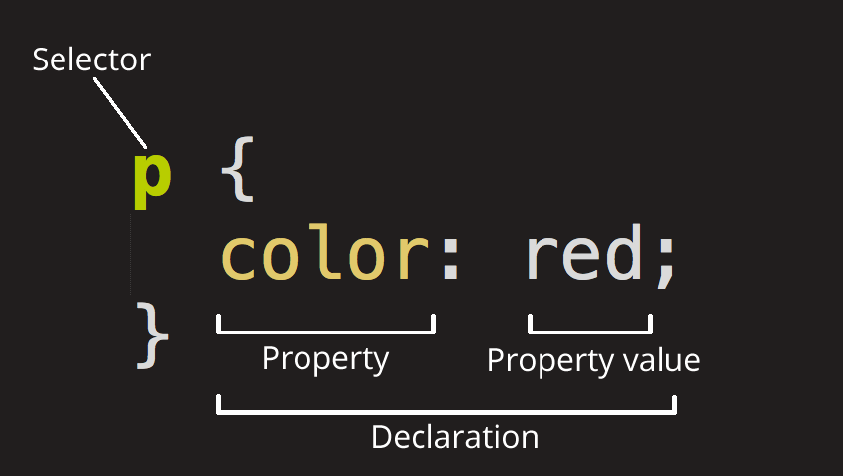
CSS
CSS means Cascading Style Sheet which is use for the deigning or styling in the HTML.
CSS allows us to specify how to present (render) the document info stored in the HTML.
Thanks to CSS we can control all the aspects of the visualization and some other features:
Colors: content, background, borders
Margins: interior margin, exterior margin
Position: where to put it
Sizes: width, height
Behaviour: changes on mouse over

Slide 11
CSS example
* {
color: blue; /*a comment*/
margin: 10px;
font: 14px Tahoma;
}
This will change all the tags in my web (‘*’ means all) to look blue with font Tahoma with 14px, and leaving a margin of 10px around.

Slide 12
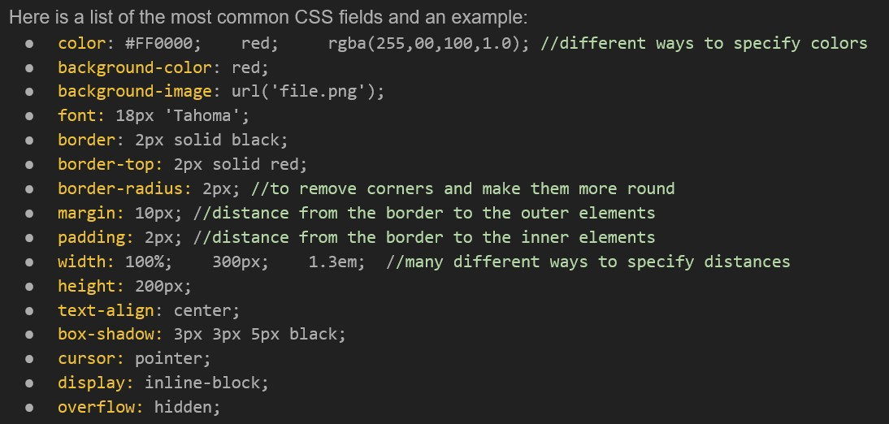
CSS fields

Slide 13
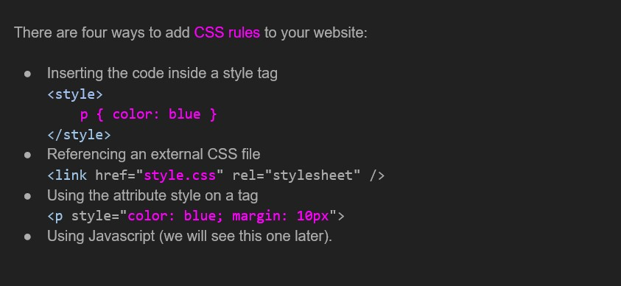
CSS: how to add it ?

Slide 14
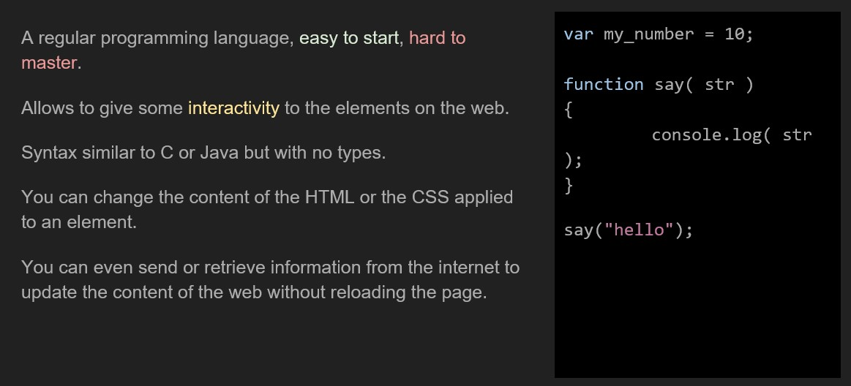
JavaScript

Slide 15
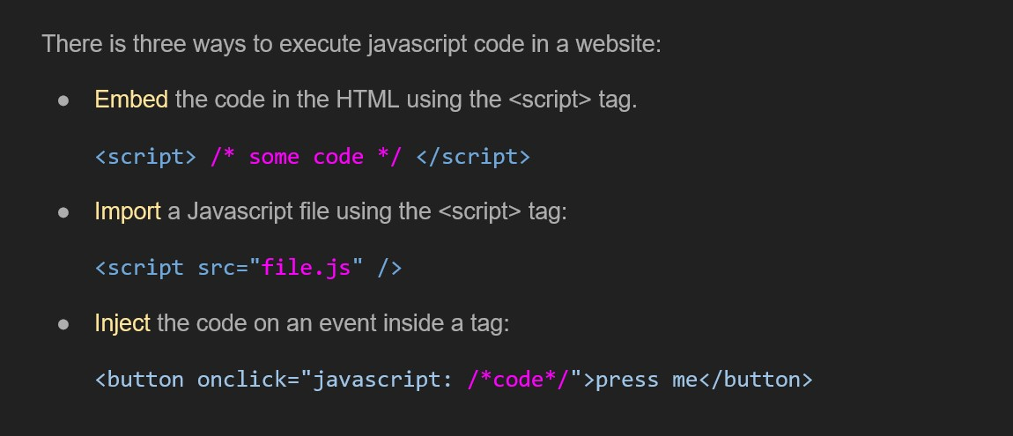
JavaScript: insert code

Slide 16
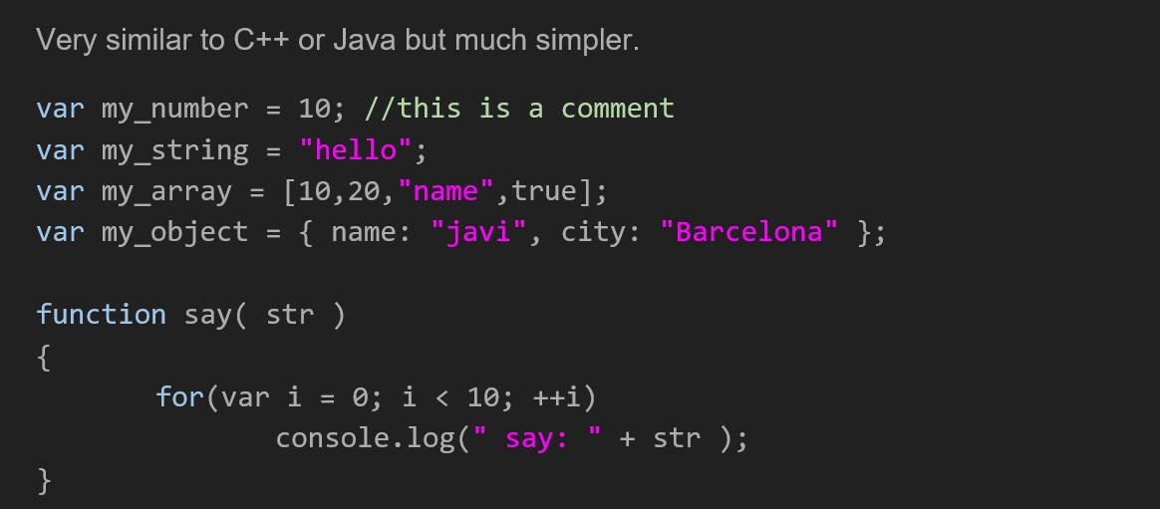
JavaScript: Syntax

Slide 17
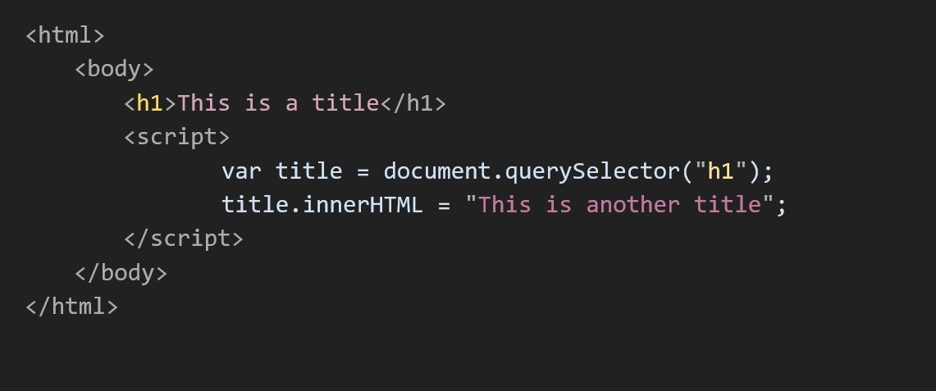
JAVASCRIPT example

Slide 18
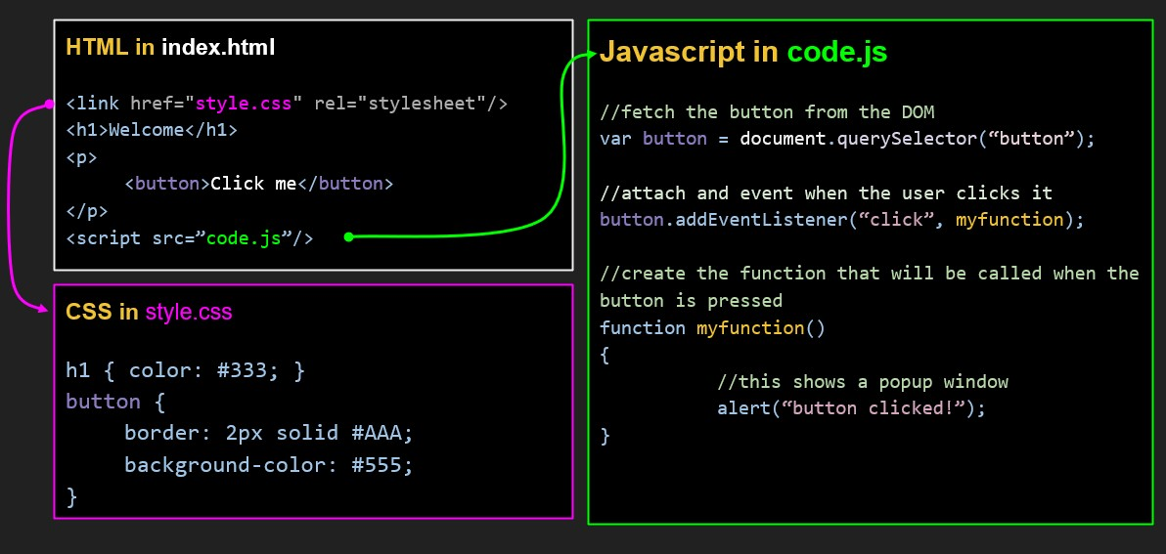
EXAMPLE OF A WEBSITE

Slide 19

Thank You

